Slide 1


Python: Advanced Topics
James Bennet
Andrew Ortego
Notes:
G97350 UC Template for Esri staff

Slide 2

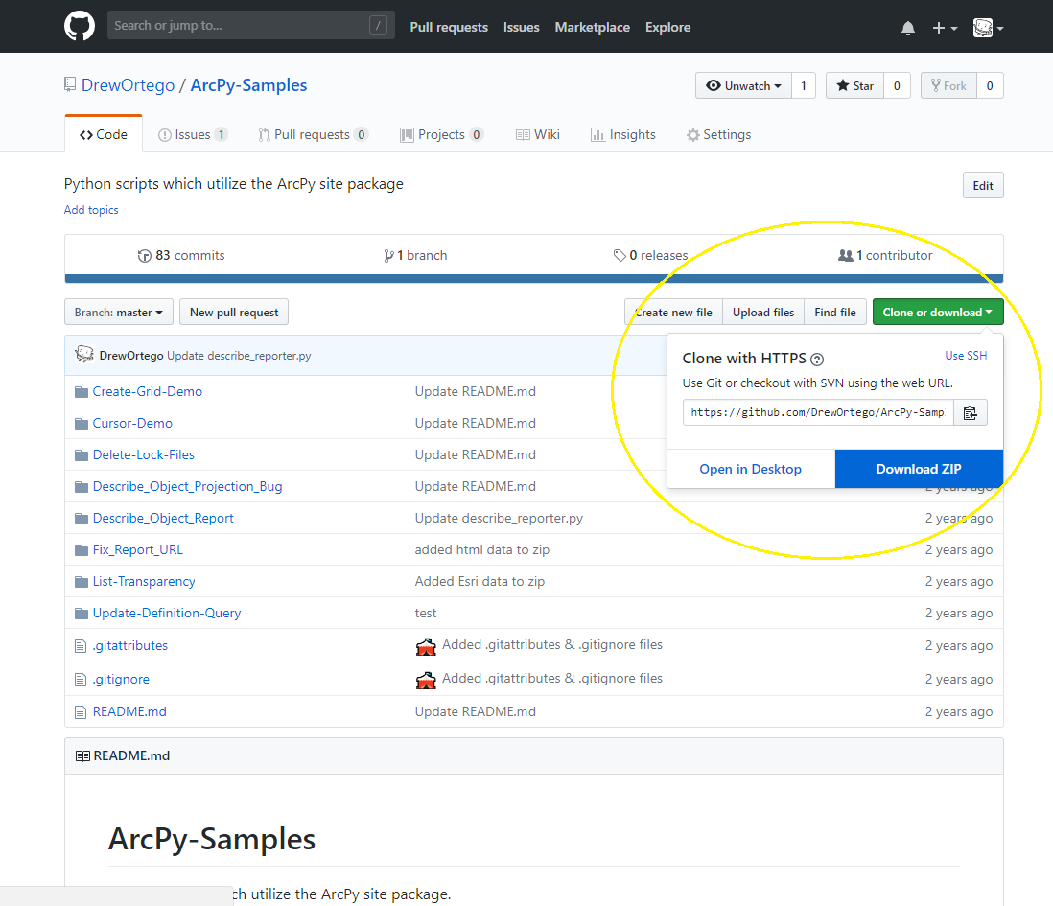
About This Presentation
All notebooks can be downloaded at https://github.com/PythonAdvancedTopics2018/Presentation
http://jupyter.org/install
Download from GitHub using the green button
Use this presentation as an introduction to the
topics and review them later
We’ll be at the Spatial Analysis and
Geoprocessing island’s all week, please bring
any questions or come say hello!

Slide 3

More Python Presentations
WORKSHOP
LOCATION
TIME FRAME
ArcGIS Pro: Working w/ Python
Building GeoProcessing Tools
ArcPy Tips and Tricks
Advanced Topics
SDCC – Room 29 C
SDCC – Room 03
SDCC – Room 30 D
SDCC – Room 03
Thursday 2:30 PM – 3:30 PM
Thursday 10:00 AM – 11:00 AM
Thursday 4:00 PM – 5:00 PM
Friday 9:00 AM – 10:00 AM

Slide 4

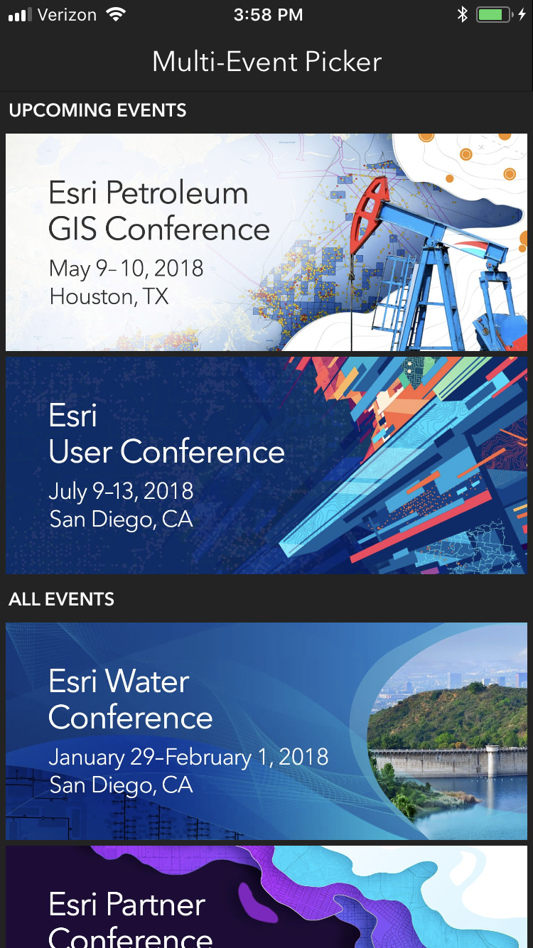
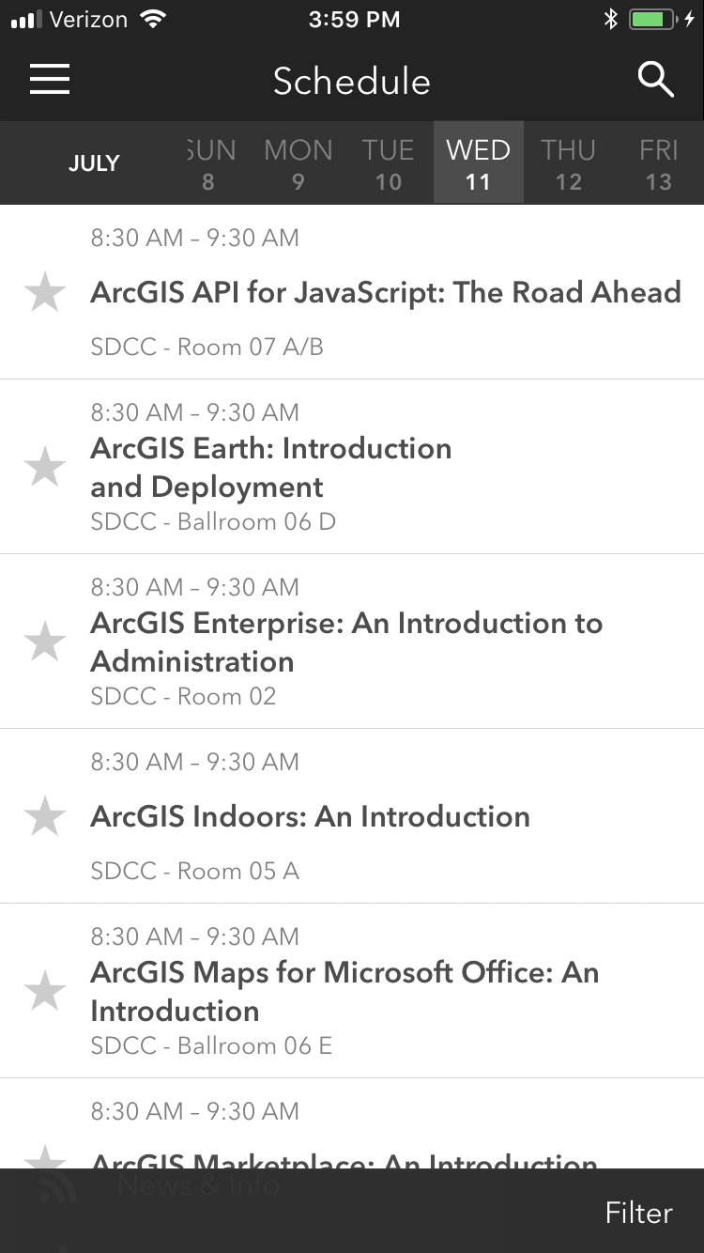
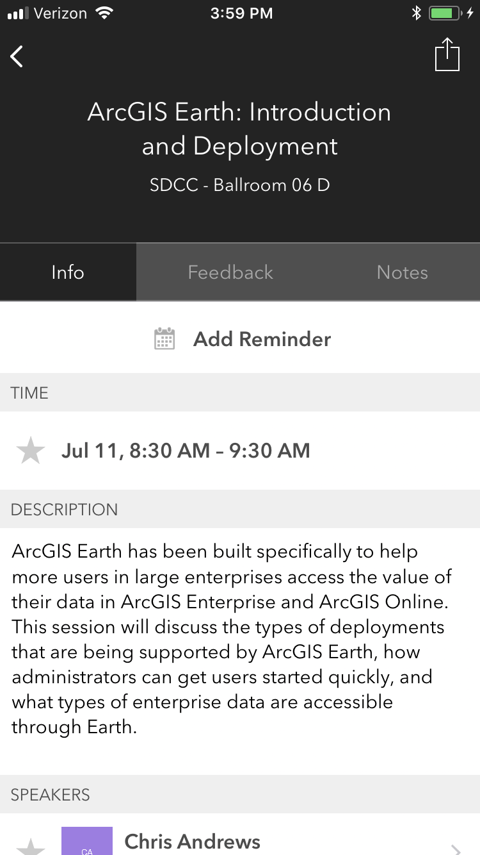
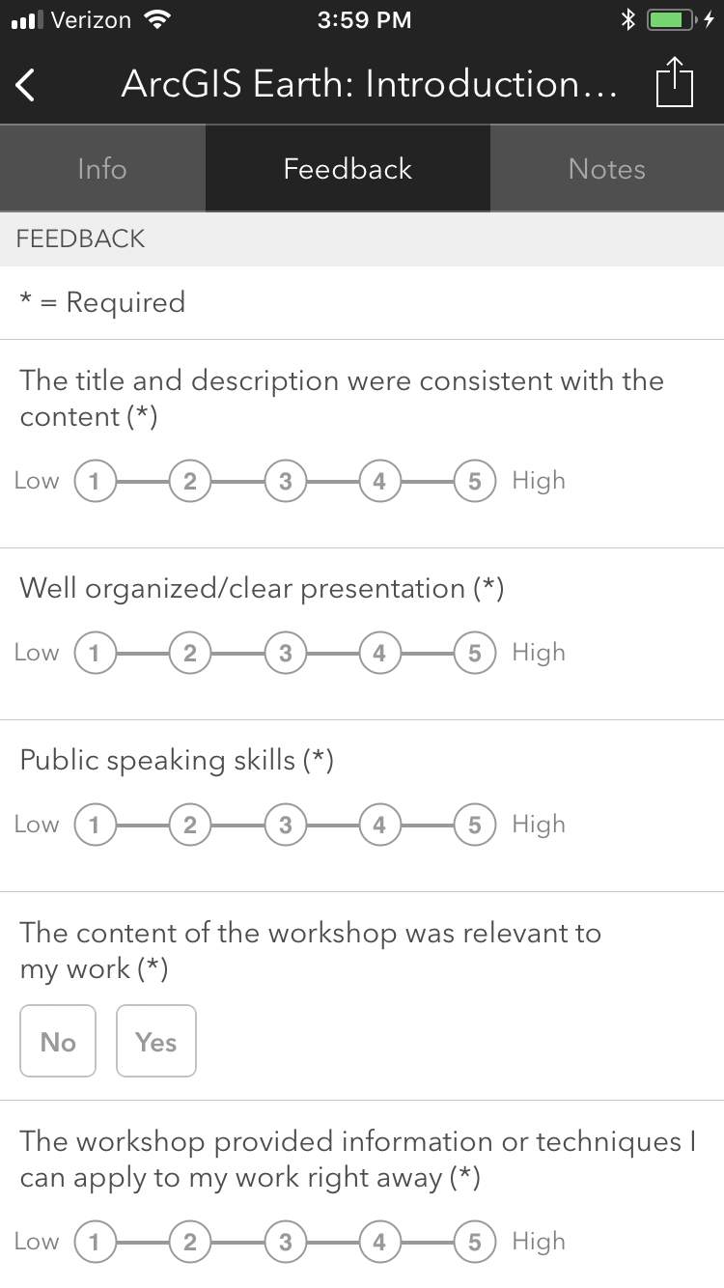
Please Take Our Survey on the App
Download the Esri Events app and find your event
Select the session you attended
Scroll down to find the feedback section
Complete answers
and select “Submit”

Slide 5



